Slide 1
Personal Projects for Parents
Nakeya Barner
Email: nbarner@apsk12.org

Slide 2
What is the MYP Personal Project?
SELF-guided inquiry into a topic of interest for the student
Mandatory
3 Components
Product/Outcome
Oral or Written Report
Process Journal

Slide 3
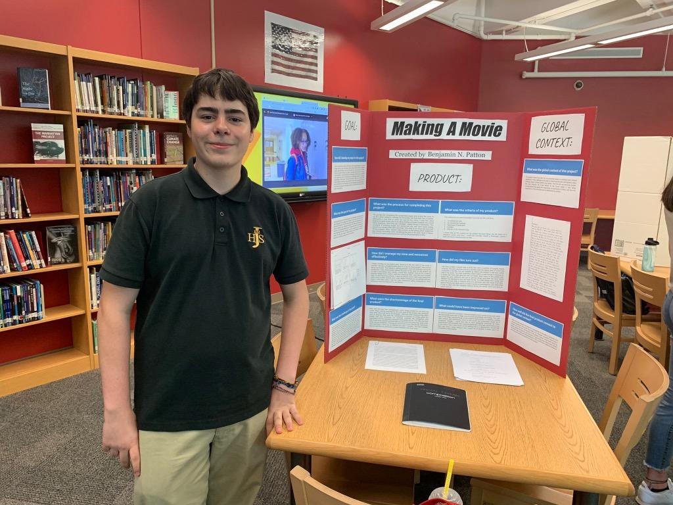
Personal Project Examples from Last Year
Goal/Outcome: Making A Movie

Slide 4
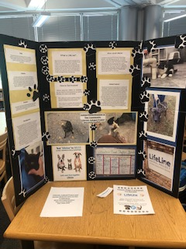
Personal Project Example
Goal/Outcome: Raise money for Lifeline

Slide 5
What is your role as a Parent?
Supply materials
Provide resources
Find mentors or professionals your child can work with under your supervision
Monitor your child’s progress through Google Classroom
Encourage them to explore new topics

Slide 6
Why should students complete the Personal Project
Preparation for IB Diploma Program classes and assessments
Increased College Acceptance
Scholarships
Cords for Graduation
Showcase Celebration
Build student responsibility and independence

Slide 7
Volunteer Opportunities
Email micdalton@apsk12.org
https://www.atlantapublicschools.us/Page/26236
Complete Information Form https://docs.google.com/forms/d/1RKmtZIX40dsG3UmdGruSCFJ5rDx9sKWO6U7rQOZ8qVQ/edit

Slide 8
Contact Information
Personal Project Coordinator: nbarner@apsk12.org
Remind: Text mjhspp10 to 81010
Download Remind App and use code mjhspp10

